Slide 1
Data Analytics with Mainframe

Slide 2
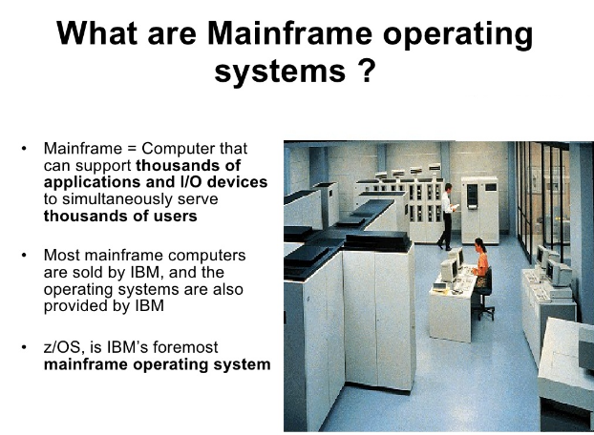
Introduction
History
In 1950s, mainframe computers were physically the largest computers; few business could afford them.
In the 1960s, with standardized mainframe customers could write business applications that didn’t need specialized hardware or software
In 1964, the introduction of the IBM System/360 (or S/360 TM) signaled the start of the 3G: first general purpose computers.
Why Mainframes?
The most important features the mainframe provides include:
Encrypt sensitive data as it crosses the network
Protect encryption keys
Provide well-known security configurations that achieve or surpass the industry standard.
Process within few seconds of billion , trillion data

Slide 3
Business Needs
Descriptive Analytics
Predictive Analytics
Prescriptive Analytics
DATA
Clinical, Claims, Monitoring, others
How are we doing?
What might happen in the future?
Best course of action given objectives, requirements & constraints
How many claims did we pay today?
Which of tomorrow’s claims might be requesting an Emergency Room (ER) admission?
What would be effective steps to reduce probability of ER admission?
Today: Analytics is about what happened
Tomorrow: Analytics will be how we do business

Slide 4
Mainframe Components
Characteristics
One Big Central System
Highly reliable (99.999%)
Batch processing
Data schema independence
Stores data mainly as files
Tape Backups
Transaction system (CICS)
CICS
CICS
Customer Information Control System
(CICS)
COBOL/Copybook
Data Processing
Data Storage
DB2/DMS/
others
Tape
Backup

Slide 5
Mainframes Presence
Mainframes are critical
Major Government services including Medicare, Social Security, and Treasury
Worlds top 25 Banks
Worlds top 9 insurance company
23 of 25 Top retail companies
Mainframes are valued
Reliability: Mainframe is stable and is known to run for months without any downtime
Centralized: Easy to manage, control and is more secured
Huge data processing capabilities
Years of built and tested business logic
* Some data from “Leveraging Mainframe Data with Hadoop” by Syncsort and Cloudera Oct 2013, link

Slide 6
Predict:
Pro-Active Outage Avoidance
Predict Problems before occurrence
Log anomaly detection
IT Operational Analytics Solutions on z Systems
“Insight to action in half the time”
Optimization
IBM Capacity Mgmt Analytics.
NEW - IBM z Operational Insights (SaaS)
Investigate and Automate
NEW - IBM Operations Analytics for z Systems
NEW - IBM Common Data Provider for z/OS
Predict
NEW - IBM zAware (Anomaly Detection)
IBM Operations Analytics – Predictive Insights
Capacity Management
Software cost analysis
Enterprise resource and workload optimization
SME insights in cloud (SaaS)
Log Analytics
Domain insights and expert advice
Alert notification and automation
Unified data collection for logs and SMF
Pro-Active Outage Avoidance
Predict Problems before occurrence
Log anomaly detection
On Premise
Hybrid
Cloud
Investigate and Automate
NEW - IBM Operational Analytics for z/OS
Predict
NEW IBM zAware (Anomaly Detection)
IBM Operational Analytics – Predictive Insights
Notes:
Main Point: Analytics is now a key part of what customers are looking to improve on. As we have seen, analytics can help increase business value and IT metrics.
Analytics is about:
1. Predict problems and anomalies – Current product is OMEGAMON V5.1.1 with IBM zAware support and Netview which also includes IBM zAware support
2. Search log information and reduce mean time to root cause – The current product in this area is IBM Operation Analytics for z Systems
3. Optimize analytics for both Business and IT – Capacity Management Analytics (CMA) for z/OS, is a suite that includes SPSS, Cognos and TDSz.
Main Point: Analytics is now a key focus for our customers. As we have discussed, Operations Analytics can help increase business value by ensuring system and application availability and reducing Mean Time to Repair (MTTR).
Operations Analytics is about:
Predict - Proactively surfacing problems using anomaly detection. The current solution is IBM zAware. IBM zAware surfaces anomalies by analyzing z/OS and zLinux system logs. OMEGAMON and NetView integrate with IBM zAware by monitoring the IBM zAware anomaly scores, correlating log analysis with performance monitoring and providing the option to generate events and trigger automation.
Search - Search for information, including logs and metrics to enable a much more efficient environment for performing problem determination. The current solution in this area is IBM Operations Analytics for z Systems. IOA for z Systems integrates with ITM/OMEGAMON and Network Operations Insights.
Optimize – Provides analytics for both Business and IT. Capacity Management Analytics (CMA) for z/OS, is a suite that includes SPSS, Cognos and TDSz. CMA enables customers to forecast capacity and more recently provides a feature for forecasting the 4 hour rolling average enabling customers to manage subcap pricing.
Predict:
Pro-Active Outage Avoidance
Predict problems before they occur
Search & Analyze:
Quickly search and analyze large volumes of data from a single search bar
Perform log and performance analysis while searching
Correlate messages from multiple logs for end-to-end problem diagnosis
Optimize:
Improve performance across IT Infrastructure

Slide 7
Cost and Feature comparison
Cost of Managing 1TB of Data
$20,000 – $100,000
$15,000 – $80,000
$250 – $2,000
Mainframe
EDW
Hadoop
Scalability |  |  | 
Performance |  |  | 
Reliability |  |  | 
Agility |  |  | 
Skills Supply |  |  | 
Data from “Leveraging Mainframe Data with Hadoop” by Syncsort and Cloudera Oct 2013, link

Slide 8

Working with Mainframe is getting Harder
Business
Challenges
Mainframe expertise is retiring
Legacy applications have poor documentation
Difficult to adapt to changing business needs
Crumbling with increasing data volume, velocity, & variety
Integration Challenges
Inherently difficult to integrate
Batch processing
Data conversion and sharing is hard
Security Challenges
Hosts mission critical sensitive data
Difficult to install new software especially for data extraction
Cost Challenges
Mainframe data is (expensive) Big Data
Any processing on the mainframe even file transfers costs CPU cycles (Million Instructions Per Second - MIPS)

Slide 9
Opportunity
Processing
Mainframe processing is expensive and cost directly relates to MIPS
Any MIPS reduction = Instant Operation Expense (OpEx) Savings
Storage
Mainframe storage is expensive can be $100k/TB
Uses expensive Tape based backup
Uses custom data types such as EBCDIC, packed decimal
Hadoop Opportunity
Reduces cost in processing and storage
Can ingest any data types hence ready for Mainframe data
Address data volume, velocity, and variety challenges
Reduce risk with Subject Matter Expert (SME) availability

Slide 10
Interesting Similarities between Hadoop and Mainframe
Both are one central system supporting various applications
Both are built to be highly reliable systems
Primary processing paradigm is Batch Processing (Data processing and Analytics)
Primary data storage is file based
Metadata is separate from data. Hence schema on read is influenced
Mainframe
HADOOP
Others
JCL
OOZIE
Others
COBOL Programs
MAPREDUCE Jobs
(PIG Programs)
COPYBOOKS
HIVE Meta store
Data Files
Data Files

